Slide 1

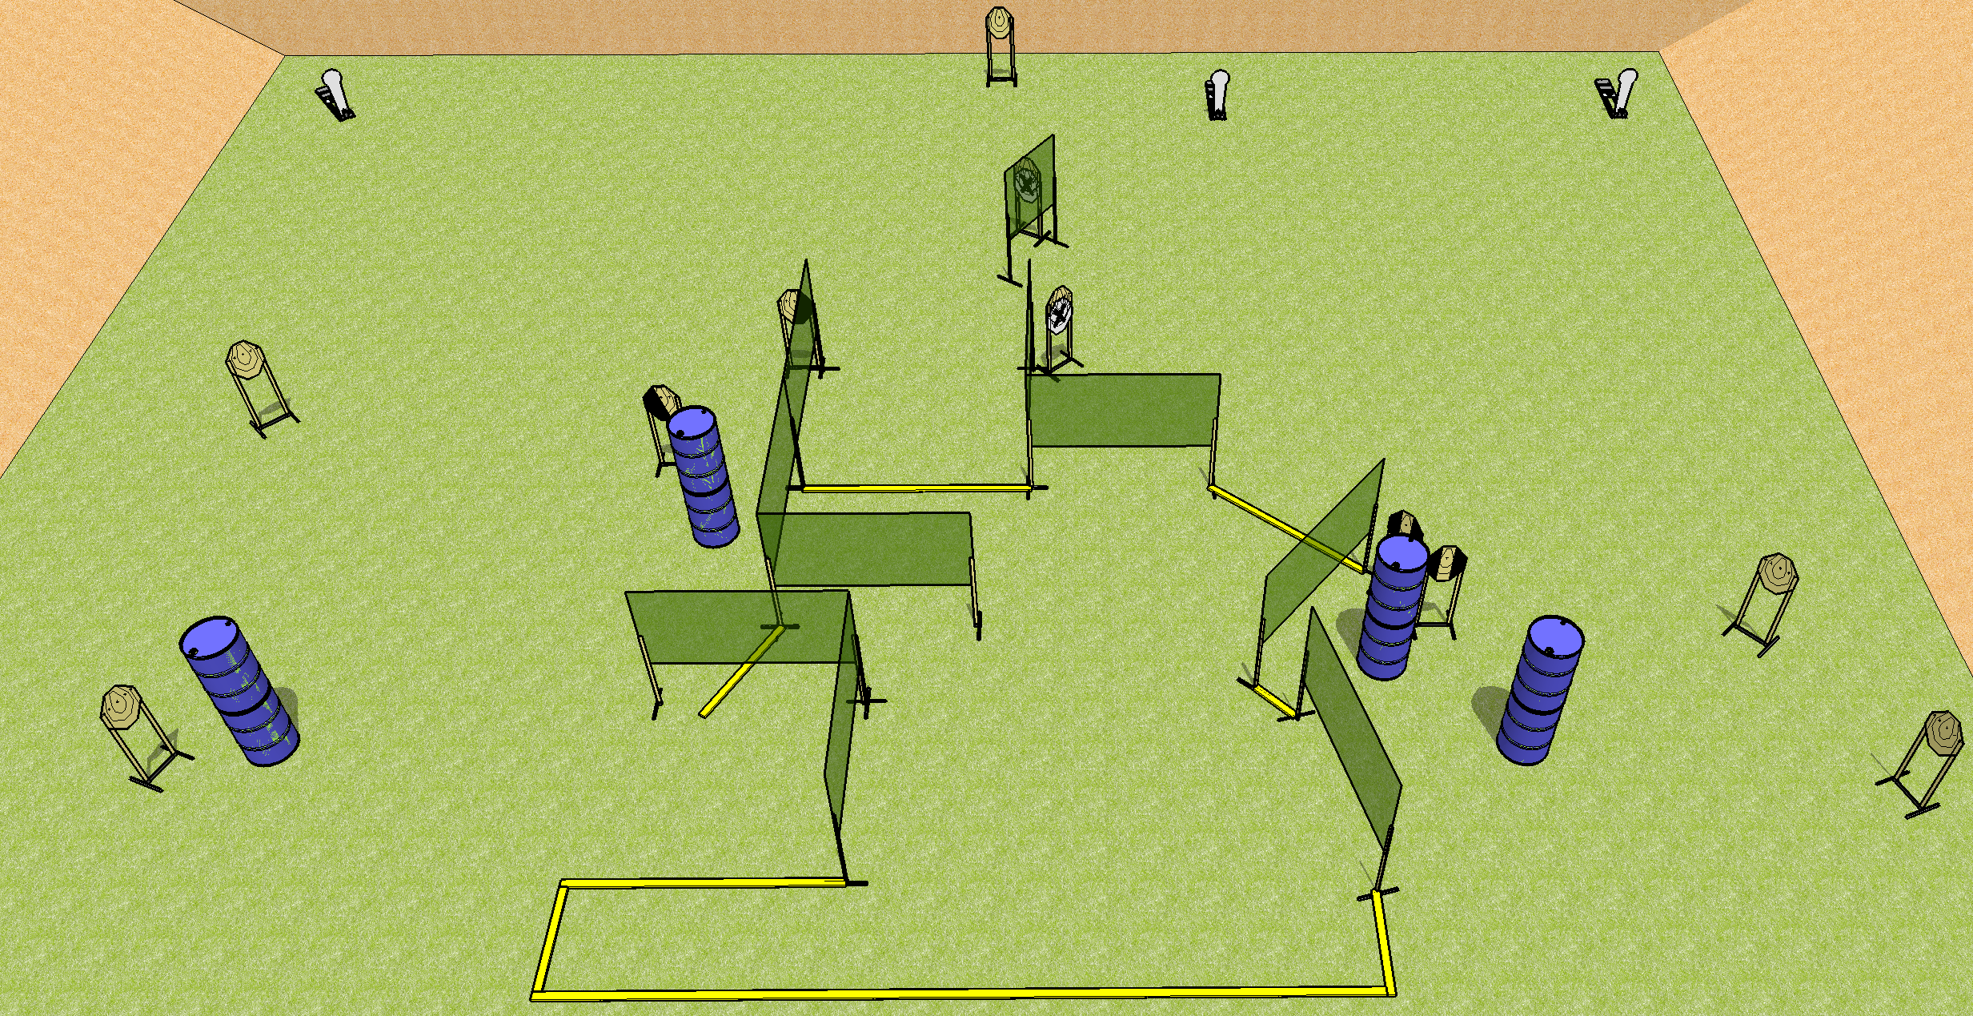
 | Dothan Practical Shooters – USPSA Match Pulling Teeth Course Designer : Drew Coleman Bay: A3
Round Count 25 rounds 11 IPSC 3 colt poppers
Equipment List 16 wall feet 1 left + 1 right diag, 2 tux 9 targets (7 + 2NS)

Slide 2
Pulling Teeth
Written Stage Briefing
Scoring: Comstock Rounds: 25
Targets: 11 IPSC, 3 steel
Handgun start position: inside the shooting area, heels touching the rear fault line, wrists below belt. Handgun is loaded and holstered.
PCC start position: inside the shooting area, heels touching the rear fault line, stock on belt. Loaded carbine is held with both hands, safety on.
Stage Procedure: on the audible start signal, engage targets as they become available from within the shooting area.

Slide 3
 | Dothan Practical Shooters – USPSA Match More Differenter Course Designer : Drew Coleman Bay: B2
Round Count 30 rounds 15 USPSA
Equipment List 1 left + 1 right diag, 1 tux 15 targets (12 + 3NS)

Slide 4
More Differenter
Written Stage Briefing
Scoring: Comstock Rounds: 30
Targets: 15 USPSA
Handgun start position: anywhere inside the shooting area, wrists below belt. Handgun is loaded and holstered.
PCC start position: anywhere inside the shooting area, stock on belt. Loaded carbine is held with both hands, safety on.
Stage Procedure: on the audible start signal, engage targets as they become available from within the shooting area.

Slide 5
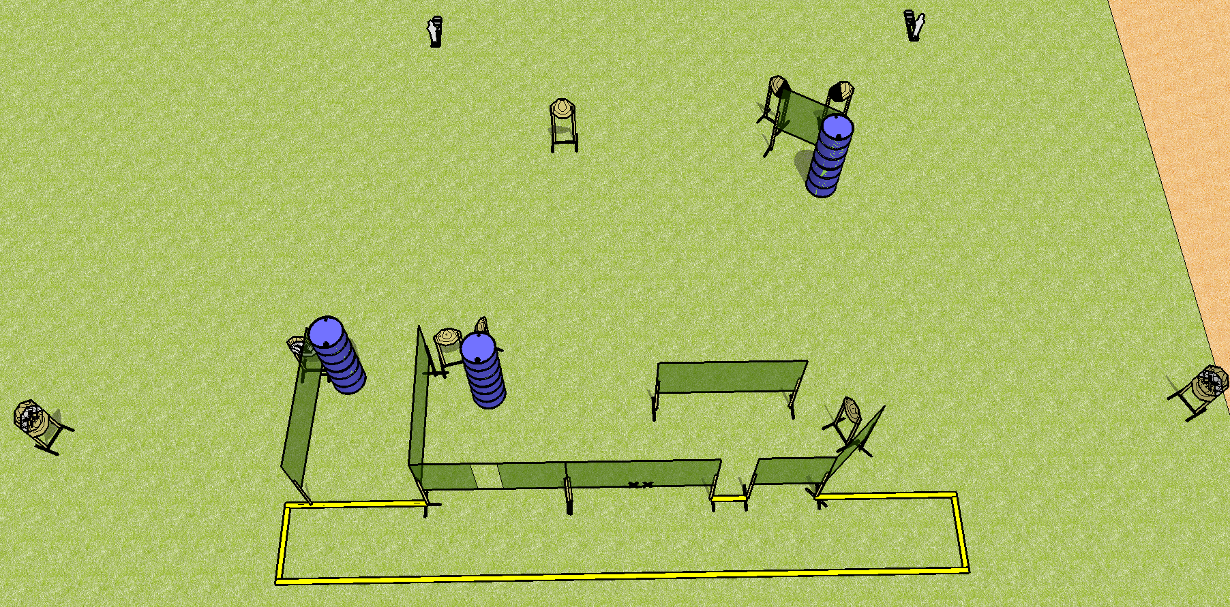
 | Dothan Practical Shooters – USPSA Match Terrible Name Course Designer : Drew Coleman Bay: A2
Round Count 24 rounds 11 IPSC 2 mini poppers
Equipment List 14 wall feet

Slide 6
Terrible Name
Written Stage Briefing
Scoring: Comstock Rounds: 24
Targets: 11 IPSC, 2 steel
Handgun start position: hands touching marks. Handgun is loaded and holstered.
PCC start position: muzzle touching either mark, stock on belt. Loaded carbine is held with both hands, safety on.
Stage Procedure: on the audible start signal, engage targets as they become available from within the shooting area.

Slide 7
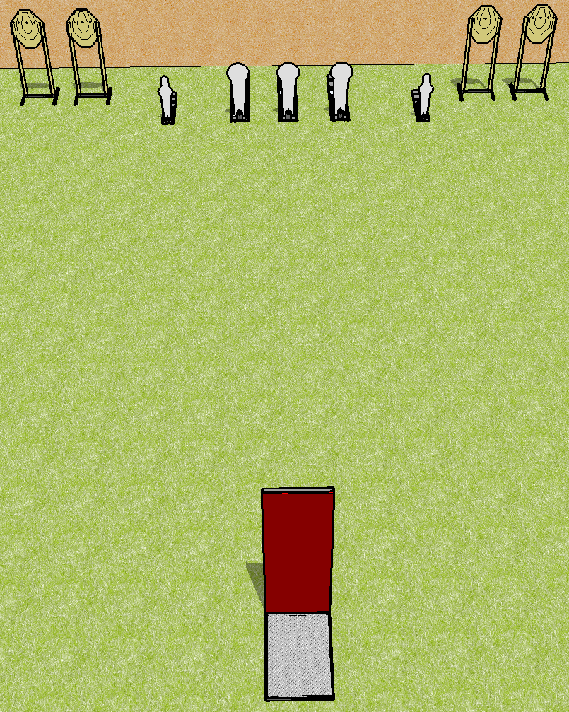
 | Dothan Practical Shooters – USPSA Match It’s the same from here Course Designer : Drew Coleman Bay: B3
Round Count 13 rounds 4 IPSC 2 mini poppers, 3 colt poppers
Equipment List Barricade

Slide 8
It’s all the same from here
Written Stage Briefing
Scoring: Comstock Rounds: 13
Targets: 4 IPSC, 5 steel
Handgun start position: Inside the shooting area, behind the barricade, wrists below belt. Handgun is loaded and holstered.
PCC start position: Inside the shooting area, behind the barricade, stock on belt. Loaded carbine is held with both hands, safety on.
Stage Procedure: on the audible start signal, from within the shooting area, engage T1-T2 and MP1 from the left side of the barricade OR T3-T4 and MP2 from the right side of the barricade, perform a mandatory reload, and engage the remaining array from the corresponding side. The colt poppers may be engaged at any time from either side.
See rulebook Appendix A3 for definition of “behind”

